Slide 1
S20.20-2014 Changes and Procedures
ESD Control Experts
© 2015 Desco Industries Inc.
StaticControl.com

Slide 2
ESD Association Standard ANSI/ESD S20.20-2014
For the Development of an
Electrostatic Discharge Control
Program for –
Protection of Electrical and Electronic
Parts, Assemblies and Equipment
(Excluding Electrically Initiated
Explosive Devices)

Slide 3
Agenda
1. Changes 2007 to 2014
2. Test Procedures

Slide 4
CHANGES

Slide 5
Transition period
Companies certified
2015 transition period
Companies previously certified to ESD S20.20-2007.
New company certification ESD S20.02-2014
All companies certified after 2016
Using standard as guideline

Slide 6
CDM events
What is a CDM event?
Value - 200 Volts Charge Device Model threshold
Importance of understanding Device sensitivity
Component sensitive to less than 200 V CDM?

Slide 7
Isolated Conductors
What is a isolated conductor
Value – 35 volts
Importance of measuring isolated conductors
Voltage higher then 35 volts
Solution
Ground or equipotentally bonded
Neutralize via ionization

Slide 8
Flooring footwear system
System defined as footwear, flooring & operator
Operator voltage measurements for qualification only, both limits must be meet

Slide 9
Ionization
Use to be +/-50V
Lower limit +/- 35V
Decay time – User defined
Test method ESD STM3.1

Slide 10
Insulators
Eliminate nonessential insulators – cups, personal items etc.
Purpose – mitigate field-induced Voltage influencing CDM damage
Insulators measured at 1 inch away at 2000V – 12 inches
Insulators measured at 1 inch away at 125V – 1 inch
Neutralize via ionization
Neutralize via other charge mitigation techniques

Slide 11
Soldering

Slide 12
Personnel Wrist Strap Jack Ground Connection
Non-Monitored personnel ground point only
Including common point ground (ground block) and Ground conductor to facility ground

Slide 13
Test Procedures

Slide 14
3.0 REFERENCED PUBLICATIONS
Unless otherwise specified, the following documents of the latest issue, revision or amendment form a part of this standard to the extent specified herein:
ESD ADV1.0, ESD Association’s Glossary of Terms(2)
ANSI/ESD S1.1, Wrist Straps(2)
ANSI/ESD STM2.1, Garments(2)
ANSI/ESD STM3.1, Ionization(2)
ANSI/ESD SP3.3, Periodic Verification of Air Ionizers(2)
ANSI/ESD S4.1, Worksurfaces – Resistance Measurements(2)
ANSI/ESD STM4.2, ESD Protective Worksurfaces – Charge Dissipation Characteristics(2)
ANSI/ESD S6.1, Grounding(2)
ANSI/ESD S7.1, Floor Materials – Characterization of Materials(2)
ANSI/ESD STM9.1, Footwear – Resistive Characterization(2)
ESD SP9.2, Footwear – Foot Grounders Resistive Characterization(2)
ANSI/ESD STM12.1, Seating – Resistive Measurement(2)
ANSI/ESD S13.1, Electrical Soldering/Desoldering Hand Tools(2)
ESD TR53, Compliance Verification of ESD Protective Equipment and Materials(2)
ANSI/ESD STM97.1, Floor Materials and Footwear – Resistance Measurement in Combination with a Person(2)
ANSI/ESD STM97.2, Floor Materials and Footwear – Voltage Measurement in Combination with a Person(2)
ANSI/ESD S541, Packaging Materials for ESD Sensitive Items(2)

Slide 15
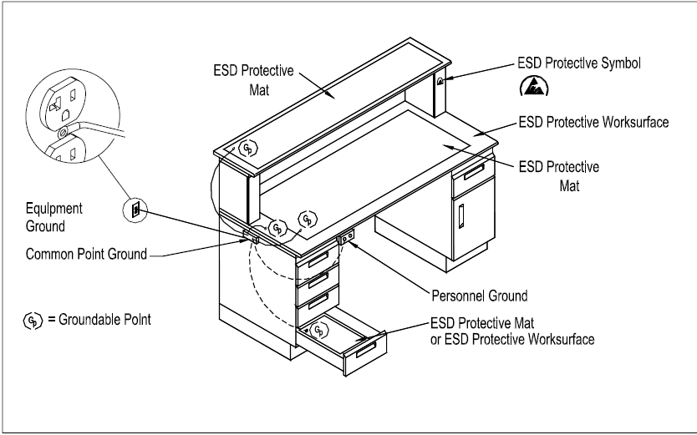
An ESD Protective Workstation connects all ESD worksurfaces, fixtures, handling equipment and personnel grounding devices to a Common Point Ground. The Common Point Ground is connected to the ESD Grounding/Bonding Reference Point, which in most cases will be the AC equipment ground. If an Auxiliary ground is used, it should be electrically bonded to the AC equipment ground.

Slide 16
ANSI/ESD S1.1 Wrist Strap System Resistance Test

Slide 17
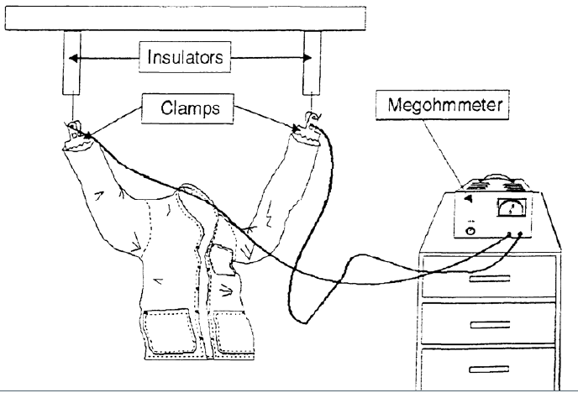
ANSI/ESD STM2.1, Garments - Test Sleeve to Sleeve

Slide 18
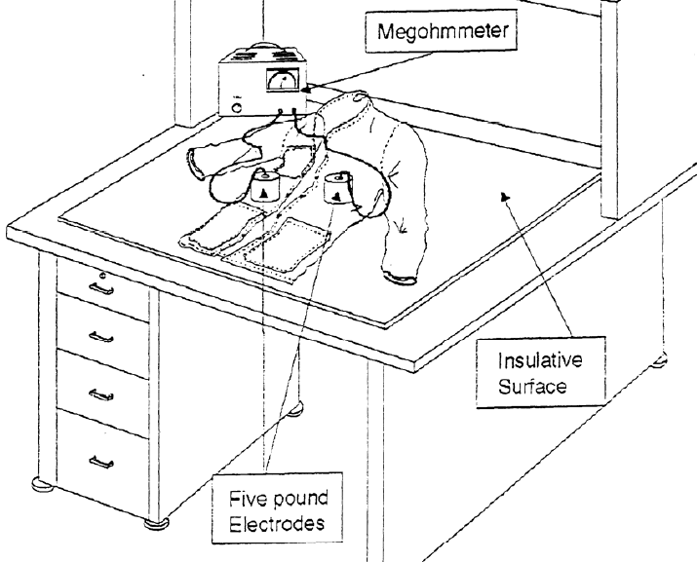
ANSI/ESD STM2.1, Garments - Test Point to Point

Slide 19
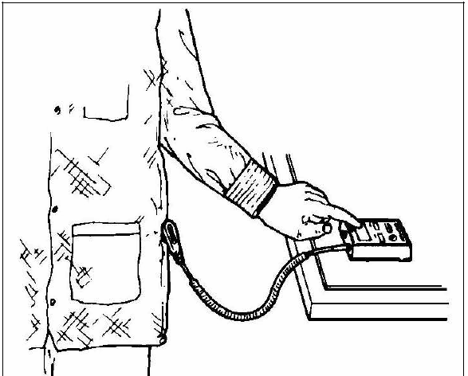
ANSI/ESD STM2.1, Garments – Groundable Garment System

Slide 20
ANSI/ESD STM3.1, Ionization – Bench Top side view

Slide 21
ANSI/ESD STM3.1, Ionization – Overhead, side view

Slide 22
ANSI/ESD STM3.1, Ionization – Air Gun, Side view

Slide 23
ANSI/ESD S4.1, Worksurfaces – Resistance Measurements

Slide 24
ANSI/ESD S6.1, Grounding

Slide 25
ANSI/ESD S7.1, Floor Materials – Characterization of Materials

Slide 26
ANSI/ESD STM9.1, Footwear – Resistive Characterization

Slide 27
ESD SP9.2, Footwear – Foot Grounders Resistive Characterization

Slide 28
ESD SP9.2, Footwear – Foot Grounders Resistive Characterization

Slide 29
ANSI/ESD STM12.1, Seating – Resistive Measurement

Slide 30
ANSI/ESD STM12.1, Seating – Resistive Measurement

Slide 31
ANSI/ESD S13.1, Electrical Soldering/Desoldering Hand Tools

Slide 32
ANSI/ESD S13.1, Electrical Soldering/Desoldering Hand Tools

Slide 33
ANSI/ESD STM97.1 Floor Materials and Footwear – Resistance Measurement in Combination with a Person

Slide 34
ANSI/ESD STM97.2, Floor Materials and Footwear – Voltage Measurement in Combination with a Person

Slide 35
ANSI/ESD STM97.2, Floor Materials and Footwear – Voltage Measurement in Combination with a Person

Slide 36
ESD TR53, Compliance Verification of ESD Protective Equipment and Materials

Slide 37
Questions and Next Steps
Thank You!

